Slide 1
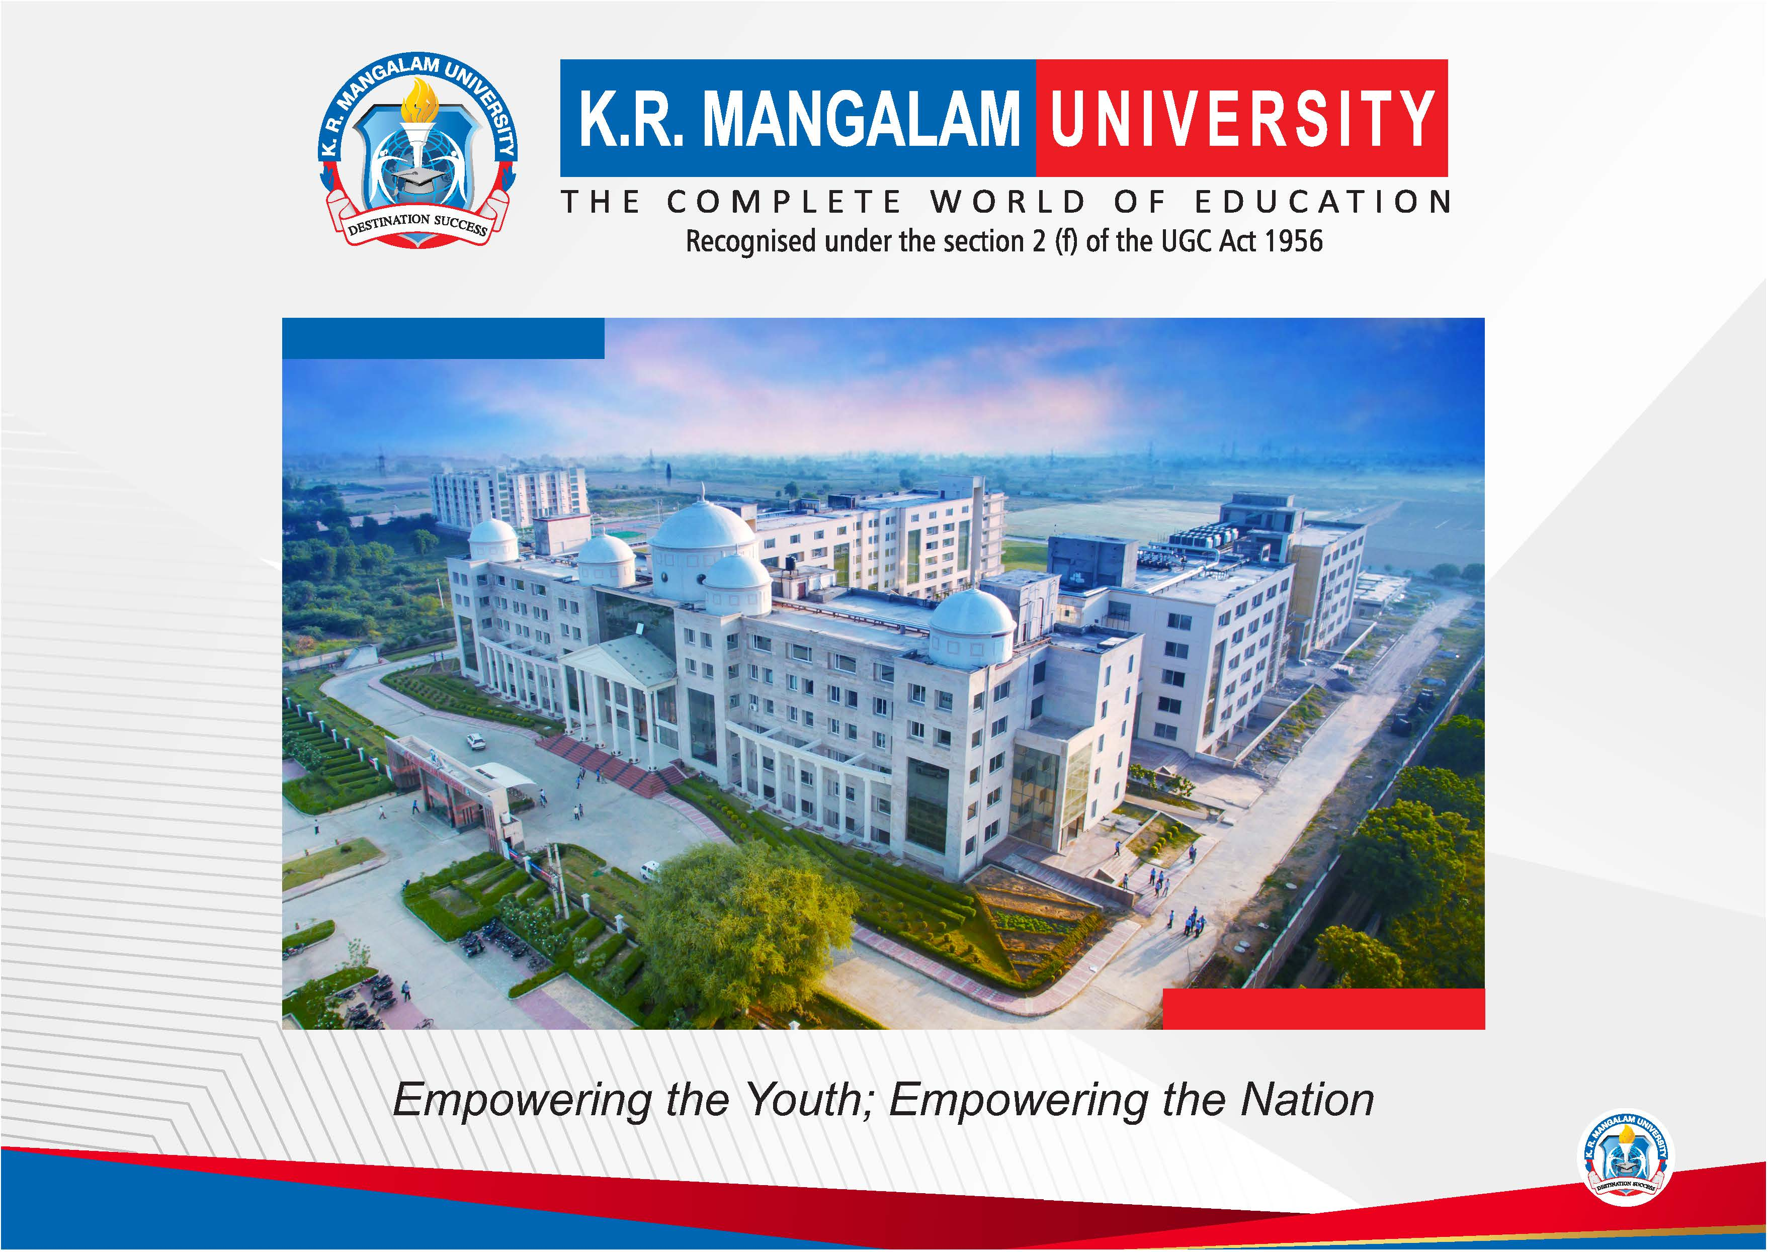

Slide 2


TEXT RECOGNITION
Pre-Final Year Project Progress
Submitted by
Roll No. | Name
2301730010 | Harddik Gupta
2301730056 | Shriya Saklani
2301730060 | Saksham Pachauri
2301730048 | Harshit Barthwal
2301730062 | Piyush Goswami
Faculty Mentor: Dr Satinder Pal Singh
Notes:
New Courses replaced with New Programmes

Slide 3

Project Overview
The project focuses on improving text recognition from degraded document images affected by noise, blur, skew, low resolution, and uneven illumination.
It proposes a Hybrid Feature Fusion Framework that combines deep spatial features from CNNs with handcrafted frequency-domain features (DWT, Gabor, LBP).
Image preprocessing techniques such as noise removal, skew correction, and contrast enhancement are used to improve input quality.
The fused features are processed using BiLSTM sequence modeling with CTC decoding for accurate text recognition.
The system achieves better accuracy and robustness than traditional OCR and CNN-only models, making it suitable for real-world applications.
Notes:
New Courses replaced with New Programmes

Slide 4
Specific Objectives
To study existing OCR techniques and identify their limitations on degraded document images.
To preprocess document images using noise removal, skew correction, binarization, and contrast enhancement.
To extract deep spatial features from images using CNN architectures
To extract handcrafted frequency-domain and texture features (DWT, Gabor, LBP).
To fuse deep and handcrafted features into a single robust representation.
To apply sequence modeling and decoding (BiLSTM with CTC) for accurate text recognition.
To evaluate and compare the proposed system with traditional and CNN-only OCR models.
Notes:
New Courses replaced with New Programmes

Slide 5
Key Features
Hybrid Feature Fusion: Combines CNN-based spatial features with handcrafted frequency-domain features for better recognition.
Robust Preprocessing: Uses noise removal, skew correction, binarization, and contrast enhancement to handle degraded images.
Dual Feature Extraction: Extracts both deep learning features and texture/frequency features (DWT, Gabor, LBP).
Sequence Modeling: Uses LSTM with CTC decoding to recognize variable-length text.
High Robustness: Performs better than traditional OCR and CNN-only models on low-quality documents.
Notes:
New Courses replaced with New Programmes

Slide 6
Progress Summary
- Completed literature review on OCR and text recognition.
- Studied existing OCR models and hybrid feature techniques.
- Selected datasets:
=> IAM dataset
=> ICDAR dataset
- Designed image preprocessing pipeline.
- Planned hybrid feature extraction architecture.
- Started initial implementation of the model pipeline.
Notes:
New Courses replaced with New Programmes

Slide 7
Detailed Progress – Development Phase
Implemented image preprocessing techniques
Noise removal
Contrast enhancement
Skew correction
Designed CNN architecture for feature extraction.
Integrated handcrafted feature extraction methods
DWT
Gabor filters
LBP
Developed hybrid feature fusion pipeline.
Notes:
New Courses replaced with New Programmes

Slide 8
Methodology
Literature review of OCR techniques
Dataset collection and preprocessing
Image enhancement and noise removal
CNN-based feature extraction
Handcrafted feature extraction
Hybrid feature fusion
Sequence modeling using BiLSTM + CTC
Model training and evaluation
Notes:
New Courses replaced with New Programmes

Slide 9
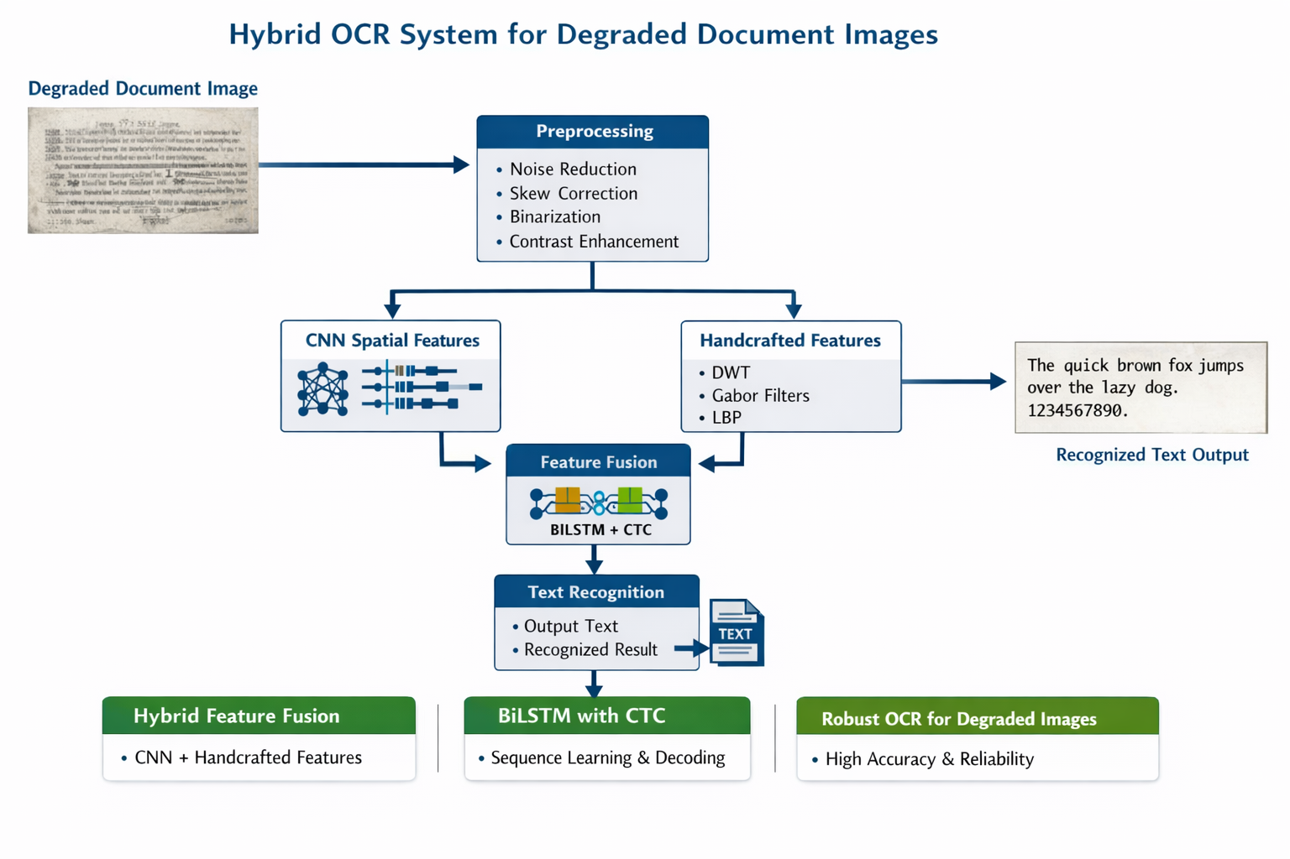

Prototype/Project Flow diagram/Architecture
Notes:
New Courses replaced with New Programmes

Slide 10
Project Timeline
Phase | Work
Jan | Literature Review
Feb | Dataset collection
Mar | Model design
Apr | Implementation
May | Testing
Jun | Final report
Notes:
New Courses replaced with New Programmes

Slide 11
Next Steps and Goals
Complete training of the hybrid OCR model
Optimize feature fusion strategy
Improve recognition accuracy
Reduce character error rate (CER)
Evaluate model on larger document datasets
Develop a working prototype OCR system
Notes:
New Courses replaced with New Programmes

Slide 12
Data & Resources
Data
IAM & ICDAR document datasets
Synthetic degraded images
Ground-truth text labels
Resources
Python
PyTorch / TensorFlow
OpenCV, PIL
NumPy, Pandas
scikit-image
Notes:
New Courses replaced with New Programmes

Slide 13
Project Usecases & Scope
Use Cases
Historical document digitization
Scanned records processing
Camera-based document OCR
Digital libraries
Automated data entry
Scope
Works on degraded document images
Supports printed & handwritten text
Handles noise, blur, and skew
Scalable for large datasets
Extendable for future OCR systems
Notes:
New Courses replaced with New Programmes

Slide 14
Expected Results & Impact
Improved OCR performance on degraded document images
Higher robustness to:
Noise
Blur
Illumination changes
Reduced Character Error Rate (CER) and Word Error Rate (WER)
Better accuracy compared to:
Traditional OCR
CNN-only OCR models
Practical use in document digitization and automated data entry
Notes:
New Courses replaced with New Programmes

Slide 15
THANK YOU

